Slide 1
LEAP-RE PILLAR 2: Research & Innovation Projects
LEAP-RE Kick-OFF MEETING 23-24 March 2021

Slide 2
LEAP-RE: Pillar 2 - The R&I Challenge
Pillar 2
Internal Consortium R&I projects and capacity building activities with substantial financial contributions from the research institutions, implemented by consortium members.
R&I projects with Capacity Building actions
Cofunded by partners 50%
Jointly developed by EU-AU «consortia»
Compliance with H2020 R&I standard of quality
Focus on the chain output-outcome-impact
Pre-leap-re (CSA)
EJP
RIA (cofunded @50%)

Slide 3

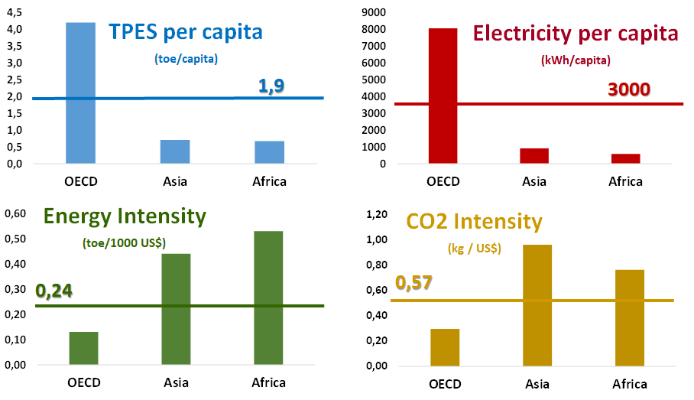
LEAP-RE: Pillar 2 - The R&I Challenge
Energy is the lifeblood of society, but the energy-climate-development nexus requires a good balance
The Africa Energy Sector development will have an increasing crucial influence
Continental Level
Africa needs a sustainable energy system (reliable, affordable and clean energy) to boost locaI socio-economic development and achieve the Agenda 2063
17% global population,
6% of global energy demand
3% of global electricity
4% of global C02 emission
Global Level
Africa’s energy transition will be crucial to the global achievement of the Agenda 2030 and the Paris Agreement's pledges also since the continent is home to many of essential raw minerals

Slide 4
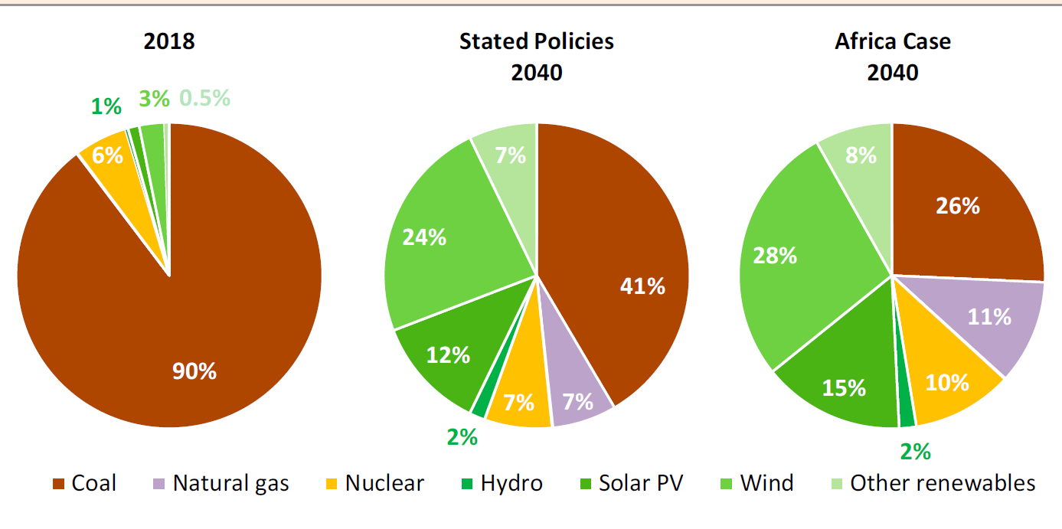
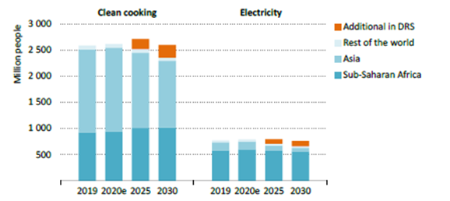
LEAP-RE: Pillar 2 - The R&I Challenge
Renewable Energy
Africa is rich in Res: potential still to be exploited even with the region’s expansion of renewable resources use.
Bioenergy, hydropower, solar and wind power and geothermal resources (East Africa).
In line with the Agenda 2030 & the Agenda 2063
Solar photovoltaics (PV) is expected to play a key role
Hydropower is also expected to grow but vulnerability to climate change require plan for long-term resilience.
REs/Hybrid Mini-grids and stand-alone systems will be essential for universal access, jobs and growth
45% SSA electrification rate
600 mln no access to electricity
800 mln no access to clean cooking
4 time electricity supply growth
COVID-19 effect
Energy Shock
Effects may be stronger for the most vulnerable regions
Economic crisis may reduce investment
Loss of job can impact on energy services affordability

Slide 5
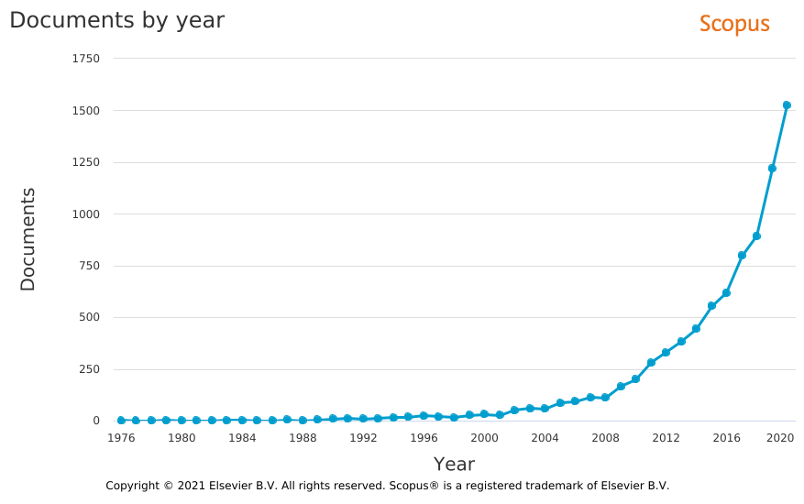
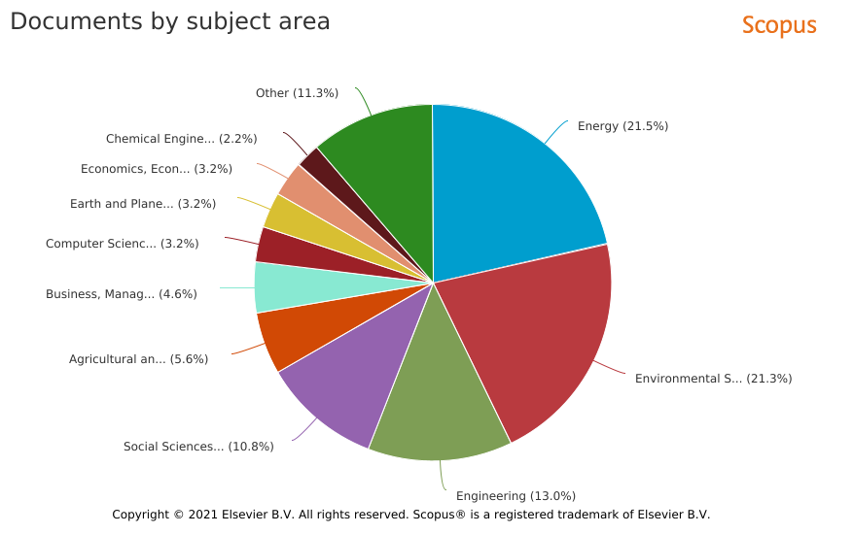
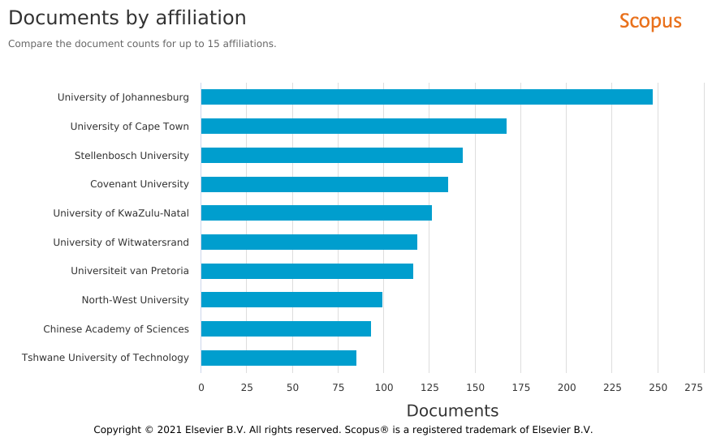
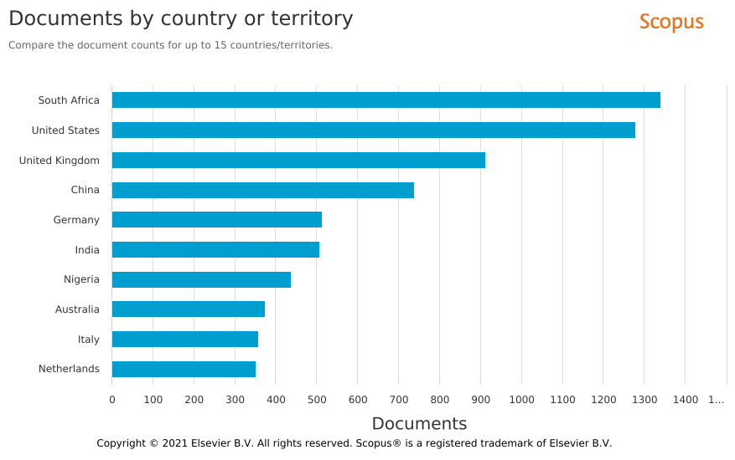
LEAP-RE: Pillar 2 - The R&I Challenge
Research interest
Increasing interest
Multidisciplinarity
South Africa leading
More African countries

Slide 6
LEAP-RE: Pillar 2 - The R&I and CB agendas
HLPD Roadmap on CCSE
Scientific Literature Review
Grey Literature (IEA, IRENA, ESMAP…)
Stakeh. consultations
PRE-LEAP-RE
ecosystem
The Comprehensive Approach to R&I and Capacity Building
Strong Methodological Approach
Technological Development
To guarantee scientific replicability and learning
To be deepened along the energy supply chain with efficiency as cross cutting element
To assure sustainability of energy technologies & solutions
Resource Assessment
Energy Scenarios and Policy
Conversion Technology
…
to understand the context where technologies and solutions are developed
Distribution and Storage
to avoid lock in solution or unforeseeable side effects
End Use Devices
to maximise long term socio-economic impact

Slide 7
LEAP-RE: Pillar 2 - The R&I and CB agendas
HLPD Roadmap on CCSE
Scientific Literature Review
Grey Literature (IEA, IRENA, ESMAP…)
Stakeh. consultations
PRE-LEAP-RE
ecosystem
The MultiAnnual Roadmaps
1 | Mapping joint research and innovation actions and resources for future RES development – Consolidation of detailed map of R&I initiatives, sources with the aim to support the RE industry to prioritize and contextualize target areas of RES deployment
2 | End‐of‐life and second‐life management and environmental impact of RE components - Map the component value chain, identification of key stakeholders & successful business models promote replicability scenarios of operational models and standard operating procedures in concerned regions
3 | Smart stand‐alone systems (SAS) - Promote the development of RE‐SAS demonstrator(s) considering the diversity of potential local RE sources and the local effective environment
4 | Smart grid (different scale) for off-grid application - Development of new tools for optimizing capacity in planning/dispatching strategies based on people’s needs to reduce the energy dependence on fossil fuel and increasing the share of RES use
5 | Processes and appliances for productive uses (PRODUSE) – Improvement and Promotion of wider us of PRODUSE appliances for Cold chain and thermal tools and equipment’s (healthcare and agriculture - livestock, fisheries and farming)
6 | Innovative solutions for priority domestic uses (clean cooking and cold chain) - Improving, managing and maintaining solar PV systems, cookstoves and cold chain components for food cooking and storage. Supporting interactions with policymaking to foster fast market uptake considering the macro socio- economic and gender impacts

Slide 8
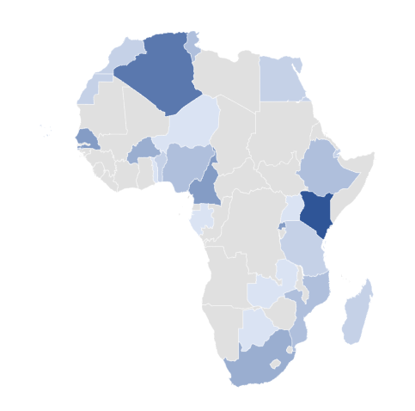
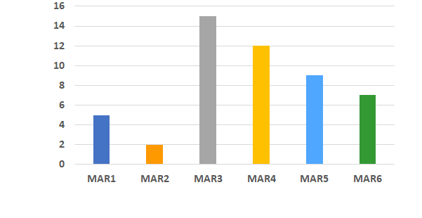
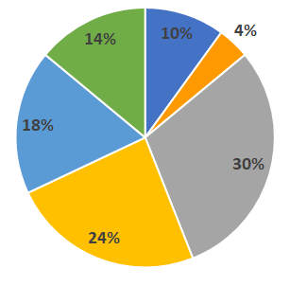
LEAP-RE: Pillar 2 - The engagement process
1° stage
engagement
2° stage
Two-Stage process
Criteria
In summer 2019 - first round
60 institutions met in a workshop in South Africa
42 proposals were submitted,
190 expression of interests received
45 countries: 21 AU and 13 EU
in autumn 2019 - second round
400 institutions received the invitation directly
Clustering was suggested
Eligibility
H2020
Impact
N Partners
N countries
EU-AU balance
Project Size
Aligned to MARs
TCIP compliant
Scientific excellency
Quality & Efficiency
Africa needs
Local stakeholder
Capacity building
Scalability
Replicability
The proposals
21 proposals to joint
152 partners
39 countries: 24 AU/15 EU

Slide 9
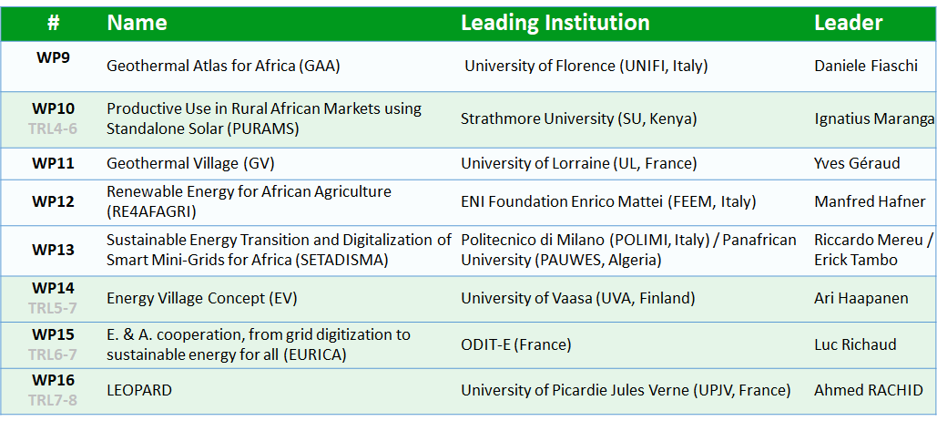
LEAP-RE: Pillar 2 - The selected proposals
63 institutions
30 countries
33 from Africa
19 countries
30 from Europe
11 countries

Slide 10
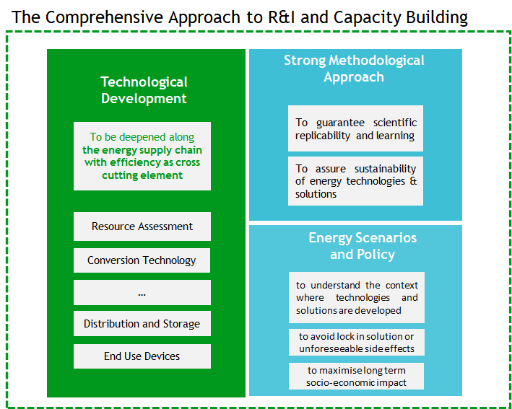
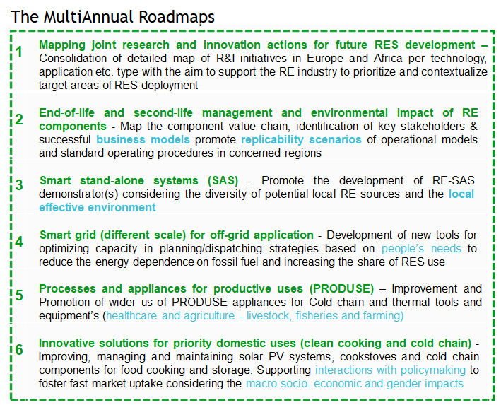
LEAP-RE: Pillar 2 - The 8 WPs R&I focus
WP9 Geothermal Atlas for Africa (GAA)
MAR 1-3-4-6
assessment, social needs
WP11 Geothermal Village (GV)
MAR 3-4-5
assessment, need-driven tech.s
WP12 Renewable Energy for African Agriculture (RE4AFAGRI)
MAR 1-3-4-5
WEF nexus, productive uses
WP13 Sustainable Energy Transition and Digitalization of Smart Mini-Grids for Africa
MAR 1-4-5
Mini-grid for local development

Slide 11
LEAP-RE: Pillar 2 - The 8 WPs R&I focus
WP10 Productive Use in Rural African Markets using Standalone Solar Cooking (PURAMS)
MAR 3-5-6
TRL 4-6 - End Uses, Jobs, Health..
WP 14 Energy Village Concept (EV)
MAR 1-3
TRL 5-7 Village-Energy communities
WP15 E. & A. cooperation, from grid digitization to sustainable energy for all (EURICA)
MAR 4
TRL 6-7 nano-mini grid, local needs
From LAB/Validated Tech to Pilot
WP16 LEOPARD REs plug in solutions in West Africa
MAR 4
TRL 7-8 containers for local needs
From Pilot to Market

Slide 12
LEAP-RE: Pillar 2 - The added value
WPs Coordination & Synergies
Peer-to-peer Scientific Support
LEAP-RE scientific dissemination
Capitalize partners’ experience
R&I + CB results outcomes
Build M&E shared principles
LEAP-RE long term impact
Pillar 3
Pillar 1
Pillar 2 works on the AU-EU partnership from the perspective of research, demonstration and technology sharing projects and
Pillar 2 contributes with ideas, competence, knowledge and opportunities (events already organised, training sessions already in placed) to the definition of the scientific dissemination plan.
Pillar 2 support the expected impacts of LEAP-RE to create a long lasting research & development cooperation through peer-to-peer R&I cooperation, trust and lesson learnt for the long term perspective

